Slide 1

Adventure Works Sales Analytics
Done By,
Akanksha
Bhavesh
Kunal
Rhishi
Rutuja
Surya
Vamsi .

Slide 2
Focus Points
Introduction
Services Offered
Business Requirement
Business Major Setbacks
Data Model
Data Model Challenges
Company Sales Outlook
Dashboard
Business Agenda

Slide 3

Adventure Works Cycles
Adventure works cycles is multinational manufacturing company based on North American, European and Asian commercial markets.
The base operation was started in Bothell, Washington with 290 employees. In 2001,Bothell manufacturing plant become the sole manufacturer and distributor of the touring bicycle product group.

Slide 4


Services We Offer
The company is mainly focused on manufacturing critical subcomponents for the cycles.
Selling metals of various parts of the cycle
Composite bicycles.

Slide 5

Business Requirement
Sales
Profit
Cost
Achieve maximum sales over various month, quarter and year.
Extracting the best-selling products over the years.
Analyzing the regions with better sales and increasing the production accordingly.
Targeting better profit among various products over month , quarter and year .
Finding the best profitable products.
Finding the best customers.
Reducing the production cost and increasing the sales and profit.

Slide 6


Major Business Setbacks
The expansion of the manufacturing plant in Mexico is crucial as it is the sole manufacturer of the critical subcomponents for the adventure cycles which is spread across North American, European and Asian Markets.
Difficulty in starting a manufacturing plant in Australia due to higher production cost and labor cost, even though Australia hold the second highest market.
The market is growing substantially high with many varieties and types which imposes a competition on the company to introduce better and efficient ones.

Slide 7
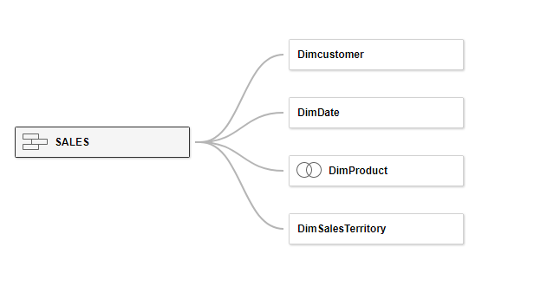
Date Model to Achieve

Slide 8
Data Model Challenges
Cleaning : The cleaning of the raw data was crucial as there were many missing data.
Loading and transformation: The loading and transforming raw data to handle inconsistencies was bit tricky.
In Tableau ,as each import makes a new connection ,we needed to incorporate all the dataset in one excel to achieve the data model and to work with single data source connection.
In My SQL , as the sales dataset was larger in size, the import was taking much time. The unused columns has been removed to speed up the import process.

Slide 9

INDUSTRY OUTLOOK
$29.4M | $12.1M | $17.3M | 18.48K | 60.40K
Sales | Profit | Cost | Customers | Orders

Slide 10
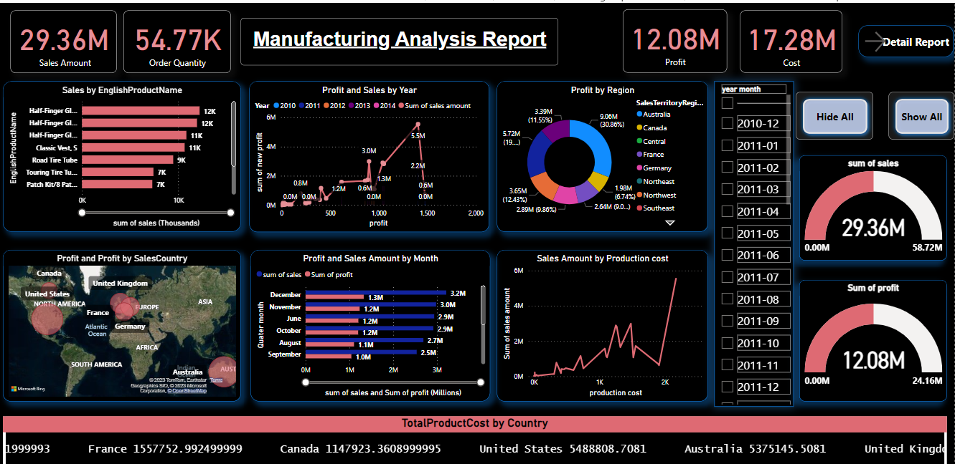

Slide 11
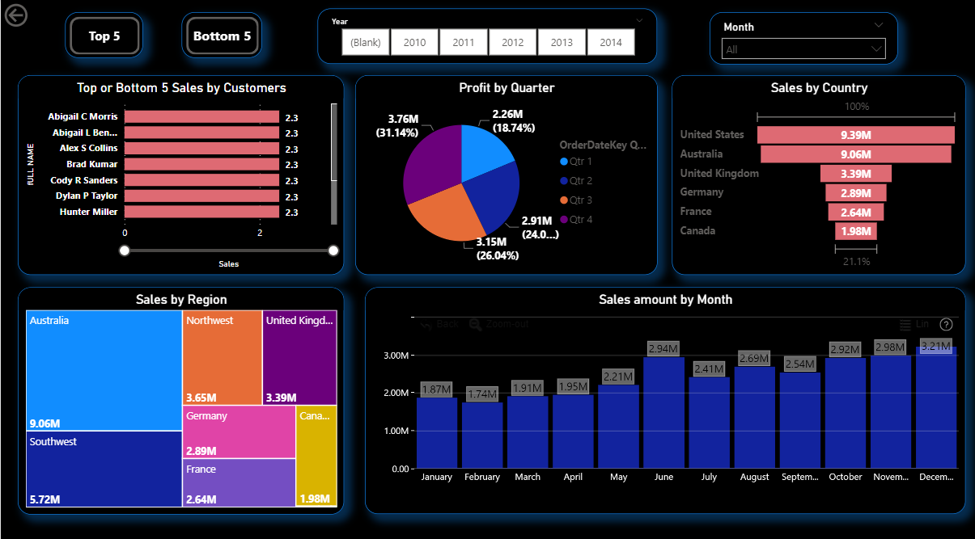

Slide 12

Adventure works Business Agenda
Adventure works company has been doing financially successful over the years.
The agenda is to
a) Expand the market share by targeting the best customers.
b) Extend the product availability through external website.
Reduce the cost of sales through lower production cost.
c)

Slide 13
d) Encouraging customers to buy newly introduced products with discounts and many launch offers and benefits.
.
e) Giving yearly gift hampers to the best customers.

Slide 14

THANK YOU!

